Slide 1



SPONSORSHIP
ADVERTISING
BRANDING & MARKETING OPPORTUNITIES
INDIA’S PREMIER TRAVEL & TOURISM EXHIBITION
www.iitmindia.com

Slide 2

SPONSORSHIP OPPORTUNITIES
Sponsorship opportunities provide cost-effective ways of
reaching a targeted audience with a greater impact.
These not only offer excellent branding opportunities to a quality audience, but also give you a wider reach across various media vehicles.
Increase your visibility to your target audience, and position
your company as an industry leader.
Sponsorship provides a variety of innovative branding, marketing and promotional opportunities.
We tailor make your needs-in terms of size of the budget.
www.iitmindia.com

Slide 3
IITM SPONSORSHIP OPTIONS
Be a premium sponsor for one of the largest Travel & Tourism Exhibitions in India
PLATINUM PARTNER
(1 Slot for each city) Rs 25,00,000/-
GOLD PARTNER
(3 Slot for each city) Rs 15,00,000/-
SILVER PARTNER
(5 slots for each city) Rs 8,00,000/-
Get premium branding space in all our marketing collateral as a Platinum Partner (Pre & Post Event EDMs, Social Media, Print & Outdoor Campaigns, Venue Branding, etc.)
Get recognized as our Platinum Partner at the press release of our event
Get a 54 Sq Mtrs (6*9 Mtrs) stall in the expo
4 Pages advertisement in our exclusive event directory circulated to over 1500 key persons of the tourism industry
Premium slots for MC announcements during the event
12 passes to all Networking Lunches & Dinners during the event
Special acknowledgment during the IITM
Awards Night Ceremony
Get premium branding space in all our marketing collateral as a Gold Partner (Pre & Post Event EDMs, Social Media, Print & Outdoor Campaigns, Venue Branding, etc.)
Get recognized as our Gold Partners at the
press Release of our event.
Get a 27 Sq Mtrs (3*9 Mtrs) stall in the expo
1 Page advertisement in our exclusive event directory circulated to over 1500 key persons of the tourism industry.
MC announcements during the event.
8 passes to all networking and dinners during the event.
Special acknowledgment during the IITM awards night ceremony.
Get premium branding space in all our marketing collateral as a Silver Partner (Pre & Post Event EDMs, Social Media, Print & Outdoor Campaigns, Venue Branding, etc.)
Get a 12 Sq Mtrs (3*4 Mtrs) Stall in the Expo
Quarter Pages advertisement in our exclusive event directory circulated to over 2000 key persons of the tourism industry
MC announcements during the event
5 passes to all Networking Lunches and Dinners during the event
Special acknowledgment during the IITM Awards Night Ceremony
www.iitmindia.com

Slide 4
IITM SPONSORSHIP OPTIONS
Be a premium sponsor for one of the largest Travel & Tourism Exhibitions in India
AWARDS FUNCTION
(1 Slot for each City) Rs 15,00,000/-
REGISTRATION DESK
(1 Slot for each city) Rs 4,00,000/-
NETWORKING DINNER
(1 slots for each city) Rs 15,00,000/-
A unique opportunity for the Event Partner, to host the biggest gathering of leading inbound tour operators and Foreign Tour Operators.
Playing host to this exclusive gathering for 250 – 300 leading tour operators, hoteliers and media will definitely enhance your brand recall!
Benefits:
18 Sq. Metre booth at a single IITM event location
Branding as Event Partner in all marketing collaterals
IITM Awards function is a unique opportunity for the Event Partner to host the biggest gathering of leading inbound & outbound faculty from the tourism industry in an exclusive award ceremony is organized to felicitate the key achievers followed by an extravagant cocktail dinner at each city.
Get 10 minutes to present your company in front of 250 – 300 leading members of the tourism fraternity
Ample branding on the Event Night
18 Sq Mtrs (3*6 Mtrs) Stall in the Expo
Branding space in all our marketing collateral as an Event Partner (Pre & Post Event EDMs, Social Media, Print & Outdoor Campaigns, Venue Branding, etc.)
Make your brand visible at this very first point of contact for all exhibitors, delegates and visitors.
Right round branding in the registration
area
Get a 9 Sq Mtrs (3*3 Mtrs) Stall in the Expo
Branding space in all our marketing collateral as an Event Partner (Pre & Post Event EDMs, Social Media,
Print & Outdoor Campaigns, Venue
Branding, etc.)
www.iitmindia.com

Slide 5
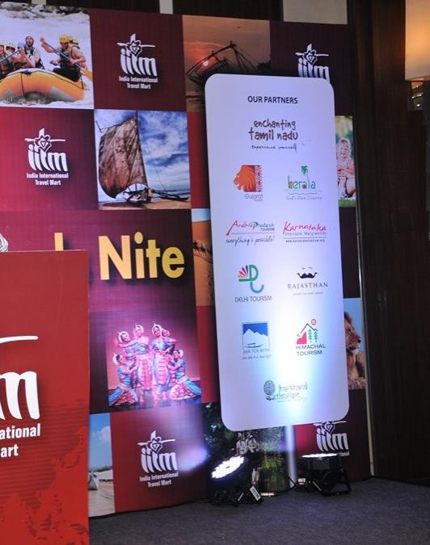
ON-SITE SPONSORSHIP
Drop Downs/Hanging Banners
Rs 50,000/- for 3
Temporary Display Board
Rs 50,000/- for 3
Walk-Way bill Boards
Rs 50,000/- for 3
LED Display
Rs 1,00,000/- (For 3
days x 20 spots of 30
sec each)
B2C Gift Branding
Rs 1,50,000/- for
25,000 pcs
Selfie Counter
Rs 60,000/- for 1
www.iitmindia.com

Slide 6

ON-SITE BRANDING
NETWORKING DINNER BRANDING
(1 Slot for each City) Rs 3,00,000/-
HELP DESK BRANDING
(1 Slot for each city) Rs 1,00,000/-
This is the very first point of contact for all exhibitors & delegates.
You can get your company name or logo on the Registration Area and score on the immense visibility that is offered at this prime location.
This Area also offers a ‘Help Desk’ facility and this is where you get repeat exposure to the travel trade invitees.
A very special by invitation only, networking dinner function is proposed for every event.
It is here that you will have a chance to meet all the travel trade.
This is the right place to make your mark.
Special focus is given to your company and this is the ideal time to introduce new products/services by having a 10 minutes presentation before the dinner.
Special coverage is given to your company with a stage back drop and also when your banner is displayed at the venue.
www.iitmindia.com

Slide 7
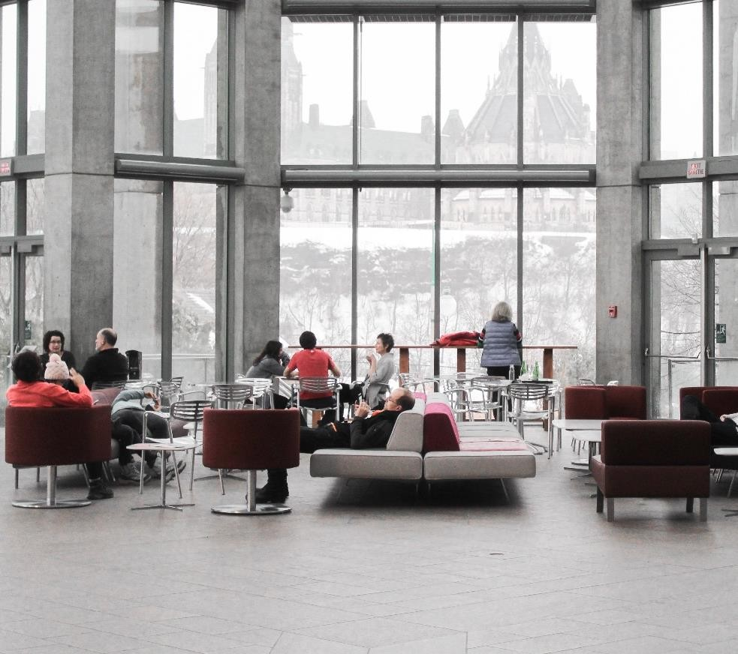
VIP/MEDIA LOUNGE
INTERACTIVE VIP MEDIA LOUNGE
(1 Slot for 3 days each City) Rs 3,00,000/-
A very special by invitation only, interactive networking lounge with exclusive media interaction that will add brand value.
Pre-event coverage and post event coverage from Local and National Media.
Special focus is given to your company by having a 10 minutes interaction with the media.
You can get your company name in the lounge area and score immense visibility, that is offered in this prime location.
www.iitmindia.com

Slide 8

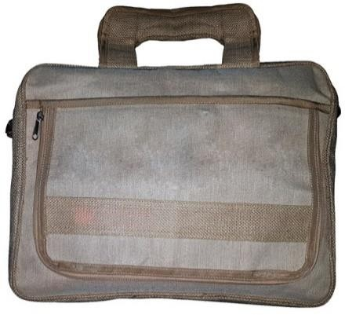


OTHER SPONSORSHIP
Buyers & Sellers Kit Bags
Your logo will appear on the bag. Welcome bags containing information about the exhibition will be distributed to Sellers, Press & Buyers.
Lanyard
Your logo will appear on the lanyard. Attractive lanyards are produced to hold the entry badges and distributed to all exhibitors, trade visitors, press, delegates, VIPs.
Exhibitors Kit
Provide visitors with show bags to help them collect information. Your logo and message will appear on the show carry bags to be distributed from the registration area and help desk counters.
Slots: 4, Charges: Rs.1,00,000/-
Slots: 4, Charges: Rs.75,000/-
Slots: 4, Charges: Rs.2,00,000/-
www.iitmindia.com

Slide 9


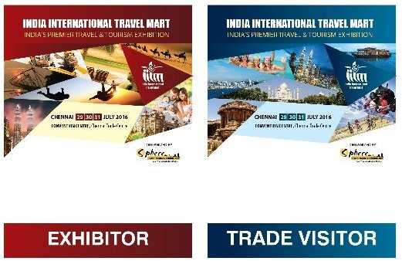
OTHER SPONSORSHIP
Drinking Water
5000 drinking water bottles are distributed to all exhibitors and kept in Buyers' lounges. Sponsoring it is a cost-effective means to generate goodwill.
Badges
The badge is one of the widely distributed and most visible element. Badges will be provided to all participants, trade visitors, press, delegates, VIPs. Your logo will appear in the main section of the badge.
Exhibitors Directory
Directory has an enormously long shelf life, as it’s becomes a Reference Source for the buyers & sellers, with full page advertisement of your company offers you along lasting visibility at the event as well the post-event visibility.
Slots: 1, Charges: Rs.1,00,000/-
Slots: 4, Charges: Rs.75,000/-
Charges: Rs.25,000/- (Only for logo)
www.iitmindia.com
9

Slide 10
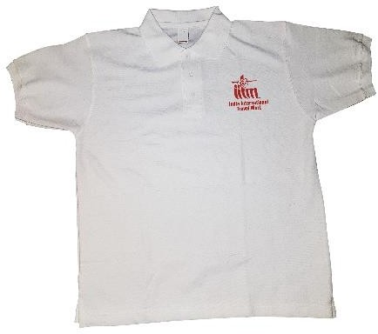
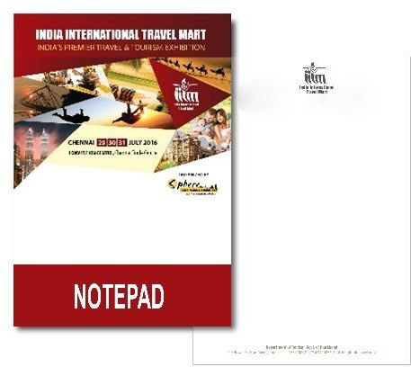
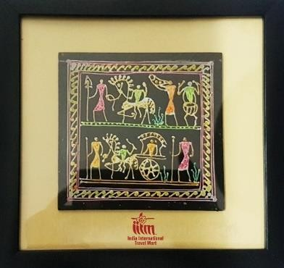
OTHER SPONSORSHIP
Souvenirs
Reach out to the trade invitees by gifting them a memorable souvenir of your choice with your brand logo printed.
T - Shirts
Get your brand featured on the 250 T-SHIRTS,
custom-made souvenirs for the event.
Print Material
We offer a package so you can reach out to the trade people you missed meeting. We can include your brochure/print material, souvenirs in the kit bag that we give to every tour operator/travel agent/exhibitor.
Slots: 4, Charges: Rs.1,00,000/-
Slots: 2, Charges: Rs.50,000/-
Slots: 2, Charges: Rs.1,00,000/-
www.iitmindia.com

Slide 11
Advertisement In IITM Directory
For Exhibition Directory
Double Spread | Size (420mm x 297mm) | Rs. 2,50,000/-
Back Cover | Size (210mm x 297mm) | Rs. 1,50,000/-
Inner Cover | Size (210mm x 297mm) | Rs. 75,000/-
Full Page | Size (210mm x 297mm) | Rs. 20,000/-
Advertisement artwork will be provided by you.
*Tax Applicable
www.iitmindia.com

Slide 12

THANK YOU
Sphere Travelmedia & Exhibitions Pvt. Ltd. #245 Amar Jyothi Layout, Bangalore - 560071, Karnataka, India.
Office Tel: +91 80 40834100
www.spheretravelmedia.com
www.iitmindia.com

